Slide 1
Chapter 3: Re-Engineering Process Activities
Software Re-engineering - Undergraduate Course

Slide 2
Why Process Activities Matter
Provide structure to re-engineering projects
Ensure systematic recovery and improvement
Reduce risks and costs

Slide 3
Major Activities
System Analysis
Reverse Engineering
Restructuring
Forward Engineering

Slide 4
Re-engineering Activities Workflow
Analysis
Reverse Engineering
Restructuring
Forward Engineering

Slide 5
System Analysis - Definition
System Analysis in software re-engineering is the process of studying and understanding the existing software system to identify its structure, functionality, performance, and problems — with the goal of determining what needs to be changed or improved.
Before rebuilding a system, first understand what it does, how it works, and where it fails.

Slide 6
Why It’s Important
When you re-engineer software, you’re not starting from scratch — you’re improving something that already exists.
System analysis ensures you don’t lose valuable functionality while removing inefficiencies or outdated designs.
Understand how the current system operates.
Identify areas that need improvement.
Ensure compatibility with new technologies.
Avoid costly mistakes during redesign or migration.

Slide 7
Objectives of System Analysis
Objective | Description
Understand Existing System | Study architecture, modules, and workflows.
Identify Weaknesses | Detect performance bottlenecks, redundancy, or outdated code.
Capture Business Rules | Document the logic and constraints that the system enforces.
Determine Re-engineering Scope | Decide what to keep, modify, or replace.
Support Future Design | Provide data and models for re-engineering decisions.

Slide 8
Steps in System Analysis for Re-engineering
1. System Understanding
Review system documentation (if available).
Analyze source code, data structures, and database schemas.
Use tools for reverse engineering to extract design models (e.g., UML diagrams).
Example:
Generating a class diagram from old Java code to understand its relationships.

Slide 9
2. Data and Process Analysis
Identify data flow, input/output, and process dependencies.
Create DFDs (Data Flow Diagrams) or ERDs (Entity Relationship Diagrams) to visualize information flow.
Helps reveal how modules interact and where data redundancy occurs.

Slide 10
3. Performance and Quality Assessment
Measure performance metrics like response time, memory use, and throughput.
Evaluate maintainability, reliability, and security.
Tools: Profilers, code analyzers, performance monitors.
Notes:
Profilers are tools used to analyze the runtime behavior of a program. They help identify bottlenecks, inefficient code paths, CPU or memory usage issues, and performance hot spots — all critical during migration or modernization. Profilers tell you where your program spends its time and how it uses system resources.

Slide 11
4. Requirements Recovery
Extract implicit requirements hidden in the code or workflows.
Understand why certain design decisions were made.
Compare existing functionality with current business needs.
This helps ensure that re-engineering doesn’t remove critical legacy behaviors.

Slide 12
5. Gap Analysis
Identify gaps between the current system and desired future state.
Classify modules as:
✅ To be Retained (working fine)
🔧 To be Modified (needs improvement)
❌ To be Replaced (obsolete or redundant)

Slide 13
6. Documentation
Prepare detailed System Analysis Report, including:
Current architecture overview
Component interactions
Detected problems
Proposed improvements
This serves as a blueprint for the next phase: System Redesign or Re-implementation.

Slide 14
Techniques Used in System Analysis
In System Analysis, especially during software re-engineering (like modernizing a legacy COBOL banking system), analysts use a variety of techniques to understand, model, and evaluate the existing system before redesigning or replacing it.

Slide 15
1. Data Flow Diagrams (DFD)
Purpose:
To visualize how data moves through the system — from inputs to processes to outputs.
Usage:
Identifies data sources, processing logic, and destinations.
Used to understand COBOL data file movements (e.g., customer → account → transaction → report).
Levels:
Level 0 (Context Diagram): Shows system boundaries and external entities.
Level 1–3: Decomposes processes into finer details.
Example: In a banking system, a DFD shows how a “Deposit Transaction” flows through modules, updates account balances, and produces receipts.

Slide 16
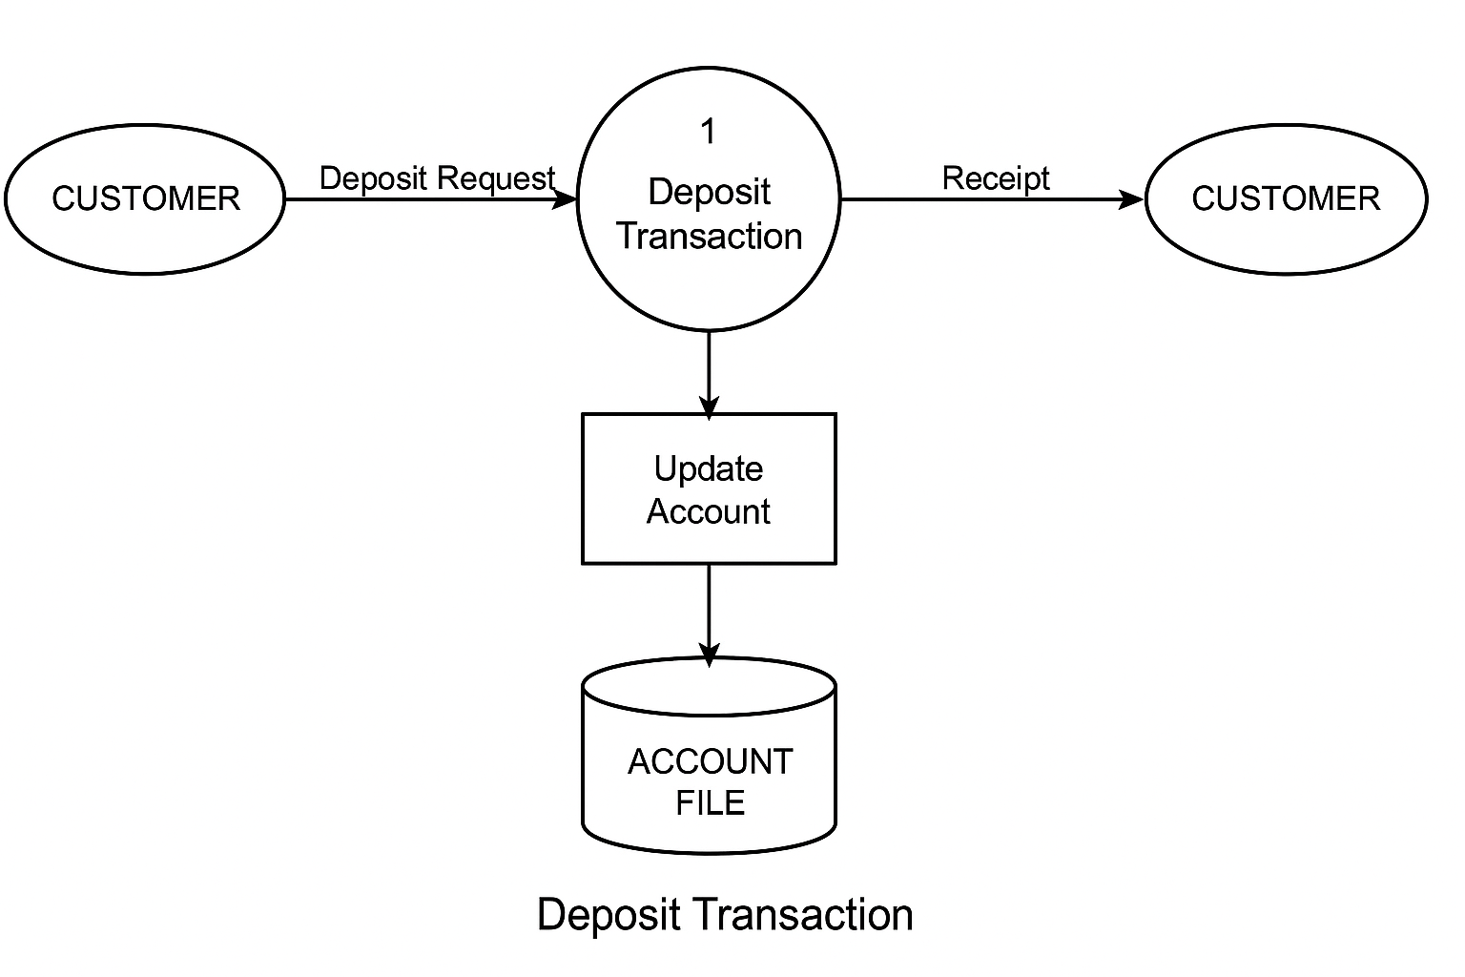

Slide 17
2. Data Dictionary
Purpose:
A centralized repository defining all data elements used in the system.
Usage:
Lists fields, data types, and relationships.
Extracted from COBOL copybooks, VSAM files, and DB2 schemas.
Example Entry:
Data Name | Description | Type | Length | Source
ACCT-NUMBER | Unique account ID | CHAR | 10 | ACCOUNT-FILE
Notes:
VSAM (Virtual Storage Access Method) is an IBM file storage system used on mainframe computers to manage and access data efficiently.

Slide 18
3. Entity–Relationship (ER) Modeling
Purpose:
To define and visualize the data structure and relationships between entities.
Usage:
Used with tools like ER/Studio or Oracle Designer.
Forms the foundation for database re-engineering.
Example:
Entities: Customer, Account, Transaction
Relationships: One customer → many accounts; One account → many transactions.

Slide 19
4. Structured Analysis
Purpose:
To decompose the system into smaller, well-defined functions.
Techniques include:
Process Specification (P-Specs): Describe logic behind each DFD process.
Structured English: Combines natural language with programming control constructs.
Decision Tables/Trees: Represent business rules for clarity.
Example:
Decision table for “Interest Calculation” depending on account type and balance range.

Slide 20
5. Reverse Engineering
Purpose:
To extract design and logic from existing COBOL code.
Usage:
Tools: Micro Focus Enterprise Analyzer, CAST AIP, SonarQube.
Generates flowcharts, call graphs, and architecture maps automatically.
Outcome:
Reconstructed architecture and dependency diagrams help identify modules to refactor or encapsulate.
Notes:
CAST AIP (Application Intelligence Platform) is a software analysis and quality assessment tool used to measure the health, maintainability, complexity, and risk of enterprise applications.

Slide 21
6. Data Flow and Control Flow Analysis
Purpose:
To trace how data variables and control logic move across the program.
Usage:
Detects unused variables, dead code, or risky data dependencies.
Helps evaluate program complexity and test coverage.
Example:
Mapping how TRAN-AMOUNT variable moves across deposit, validation, and posting modules.

Slide 22
7. Interviews and Questionnaires
Purpose:
To gather information from stakeholders, users, and IT staff.
Usage:
Identify functional gaps and user pain points.
Used early in re-engineering to confirm requirements.
Example Questions:
“Which processes are most prone to failure?”
“Which reports do you use most often?”

Slide 23
8. Automated Static Analysis
Purpose:
To assess code quality and maintainability without execution.
Tools: CAST AIP, SonarQube, Micro Focus Enterprise Analyzer.
Measures: Complexity, duplication, documentation, and security risks.
Example Result:
25 high-risk COBOL modules identified due to excessive branching and duplicated logic.

Slide 24
9. Prototyping
Purpose:
To create small working models (mock-ups) of new system features or interfaces.
Usage:
Used for validation with end users before full redevelopment.
Helps visualize migrated banking functions on a web or cloud platform.

Slide 25
10. Cost–Benefit and Feasibility Analysis
Purpose:
To evaluate whether re-engineering is justified.
Types:
Technical Feasibility: Can COBOL logic be migrated to Java or microservices?
Economic Feasibility: Do modernization benefits outweigh costs?
Operational Feasibility: Will users adapt to the new system?

Slide 26
Summary Table
Technique | Focus Area | Tool/Method Example | Output
Data Flow Diagram | Process Flow | Draw.io, Lucidchart | Process Model
Data Dictionary | Data Definition | Manual/Automated Extraction | Data Catalog
ER Modeling | Data Relationships | ER/Studio | ER Diagram
Structured Analysis | Functional Breakdown | DFD + P-Specs | Functional Model
Reverse Engineering | Code Understanding | Micro Focus Analyzer | Architecture Map
Flow Analysis | Logic Tracing | CAST, SonarQube | Flow Graphs
Interviews | User Understanding | Surveys | Requirement Summary
Static Analysis | Code Quality | CAST AIP | Risk Report
Prototyping | System Preview | Figma, HTML Mockup | Prototype Interface
Feasibility Analysis | Project Decision | Cost/Benefit Sheet | Feasibility Report

Slide 27
Outputs (Deliverables)
After System Analysis, you should have:
System Analysis Report
Data Flow Diagrams (DFD)
System Architecture Diagram
Entity-Relationship Diagram (ERD)
List of System Issues & Enhancement Opportunities
Recommendations for Re-engineering Approach

Slide 28
Example Scenario
Let’s say you have a 20-year-old payroll management system written in COBOL. During system analysis, you might find:
Finding | Action
Business rules still valid | Retain
Outdated database (flat files) | Replace with SQL DB
Complex spaghetti code | Refactor using modular design
Manual report generation | Automate with REST APIs
The result: You know exactly what to modernize and what to preserve.
Notes:
REST API (Representational State Transfer API)
A REST API is a way for different software systems to communicate with each other over the web using HTTP methods.

Slide 29
Benefits of System Analysis in Re-engineering
Minimizes risk of losing essential functionality.
Reduces rework and redevelopment costs.
Provides a roadmap for modernization.
Improves system quality and maintainability.
Ensures alignment with current business processes.

Slide 30
System Analysis - Tools
When performing system analysis during software re-engineering, engineers rely on specialized tools to:
Understand existing code structure and logic
Extract design models
Analyze data flow, dependencies, and performance
Document findings for re-engineering decisions
System analysis tools transform complex legacy systems into understandable visual and analytical models

Slide 31
Objectives of Using Tools
Automate the analysis of large, complex codebases
Recover lost documentation or architecture
Identify redundant, dead, or duplicated code
Evaluate software quality and performance
Support migration, refactoring, or modernization decisions

Slide 32
Categories of Re-engineering Tools for System Analysis
Let’s break them down into functional groups
1. Reverse Engineering Tools
Used to extract design and architecture from source code.
Tool | Function | Example Uses
Enterprise Architect | Reverse-engineers code into UML models | Generates class, sequence, and component diagrams
IBM Rational Rose / Rhapsody | Visual modeling and reverse engineering | Understands system structure and interactions
Understand by SciTools | Static code analysis and dependency visualization | Calculates metrics, detects complexity
Visual Paradigm | Generates UML and ER diagrams from code | Aids in visual understanding of system logic
Eclipse / IntelliJ UML Plugins | Reverse-engineering add-ons | Auto-create diagrams from Java or C++ code

Slide 33
2. Static Code Analysis Tools
These analyze source code without executing it, identifying complexity, dependencies, and quality issues.
Tool | Function | Example Uses
SonarQube | Code quality and maintainability metrics | Detects duplicated, dead, or insecure code
PMD / Checkstyle | Static analysis for code style and defects | Ensures coding standard compliance
CodeSonar / Coverity | Deep static analysis for C/C++/Java | Finds hidden bugs, memory leaks, vulnerabilities
Lattix Architect | Dependency structure analysis | Detects architecture violations and cycles
Helps determine system health and refactoring needs.

Slide 34
3. Dynamic Analysis Tools
These tools observe system behavior during runtime to understand performance and logic flow.
Tool | Function | Example Uses
JProfiler / YourKit | Java performance profilers | Track memory leaks, slow methods
Dynatrace / New Relic / AppDynamics | Cloud-based monitoring | Real-time tracing of microservices
Valgrind | Memory debugging for C/C++ | Detects memory leaks and threading issues
Perf / DTrace | System-level profiling | Performance monitoring in Linux/Unix
Helps identify runtime issues, bottlenecks, and optimization areas.

Slide 35
4. Database and Data Flow Analysis Tools
Used to analyze and visualize data relationships and dependencies.
Tool | Function | Example Uses
ER/Studio | Reverse-engineers databases | Generates Entity-Relationship Diagrams (ERDs)
Toad Data Modeler | Database structure visualization | Identifies schema dependencies
DBVisualizer | Database analysis and documentation | Queries and maps database connections
PowerDesigner (SAP) | Enterprise data modeling | Integrates data and process flow diagrams
Helps reveal how data moves through the system and where redundancy occurs.

Slide 36
5. Documentation and Reporting Tools
Used to automatically generate technical documentation from analysis results.
Tool | Function | Example Uses
Doxygen | Generates documentation from source code comments | Supports C/C++, Java, Python
DocFX / Javadoc | Creates API and code documentation | Useful in understanding code interfaces
Sphinx (Python) | Auto-generates project documentation | Often used with re-engineered Python systems
Creates clear documentation for the re-engineering process.

Slide 37
6. Integrated Re-engineering Suites
Comprehensive tools combining multiple analysis capabilities (reverse, static, and visualization).
Tool | Function | Example Uses
Modern Systems (ASR) | Legacy COBOL/PL1 re-engineering | Converts legacy code to modern languages
Micro Focus Enterprise Analyzer | End-to-end system analysis for legacy systems | Visualizes data flows and program dependencies
CAST Software | Application Intelligence Platform | Provides code quality, architecture, and impact analysis
Imagix 4D | Code visualization and analysis | Generates architecture, control flow, and metrics reports
These tools automate much of the re-engineering system analysis process.

Slide 38
How Tools Fit into the System Analysis Phase
System Re-engineering Workflow with Tools:
┌────────────────────────┐
│ Existing Legacy System │
└───────────┬────────────┘
│
(1) Reverse Engineering Tools
│
(2) Static/Dynamic Analysis Tools
│
(3) Data Flow & Dependency Tools
│
(4) Documentation & Visualization
│
┌────────────────────────┐
│ System Analysis Report │
│ + Architecture Models │
│ + Recommendations │
└────────────────────────┘

Slide 39
Benefits of Using Tools
Saves time analyzing large codebases
Increases accuracy of understanding legacy systems
Recovers lost design and documentation
Supports architecture visualization
Enables impact analysis before re-engineering changes
Improves code quality and maintainability

Slide 40
Example Scenario
Suppose your organization has a banking system written in COBOL.
Step | Tool | Output
Reverse Engineering | Micro Focus Enterprise Analyzer | Architecture map of modules
Static Analysis | SonarQube | Code smells and duplicated logic
Data Flow Analysis | ER/Studio | ER diagram of accounts and transactions
Documentation | Doxygen | HTML docs for COBOL functions
Reporting | CAST AIP | Maintainability and risk report
Result → A complete understanding of the legacy system, enabling effective modernization to Java or cloud-based architecture.

Slide 41
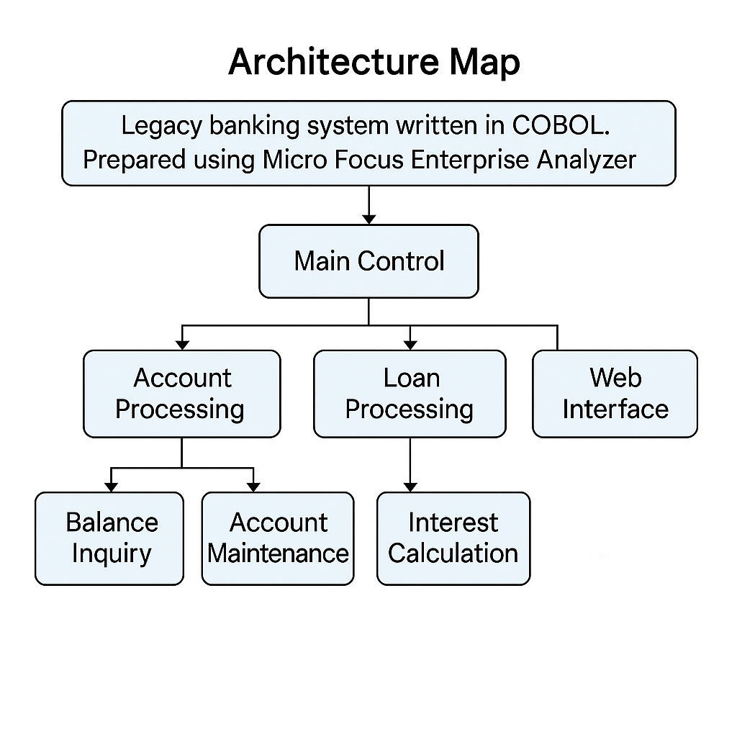

Slide 42
How SonarQube is used during the static analysis phase of re-engineering
Objective
The goal of static analysis with SonarQube is to:
Identify maintainability issues (code smells)
Detect duplicated or redundant logic
Highlight complex or risky COBOL modules
Provide a quantitative technical debt overview before modernization

Slide 43
Setup Overview
Import COBOL Source Code
Load all COBOL source files, copybooks, and JCL scripts into SonarQube via a SonarScanner or Micro Focus Enterprise Analyzer export.
Configure the SonarQube COBOL plugin (supports COBOL85 and Enterprise COBOL).
Define Quality Gate
Set rules for what constitutes a pass/fail (e.g., <5% duplication, <10 critical smells).
Run Static Analysis
SonarQube parses COBOL programs, identifies syntax structures, computes metrics (cyclomatic complexity, maintainability index), and reports issues.

Slide 44
Example Results
1. Code Smells
These indicate maintainability and clarity problems.
Issue Type | Example COBOL Pattern | Description | Severity
Long Paragraph | A paragraph exceeds 300 lines | Difficult to understand and modify | Major
Hard-coded Values | MOVE 0.07 TO WS-INTEREST-RATE | Business rules should not be hardcoded | Critical
Unused Variables | Declared WORKING-STORAGE fields never referenced | Memory and readability issue | Minor
Nested IF Statements | 4+ nested levels | Violates structured programming principles | Major
Repeated MOVE Chains | Same group of MOVE statements repeated in multiple modules | Candidate for subroutine extraction | Major

Slide 45
Sample Finding (from SonarQube Dashboard)
COBOL:LongParagraph— Paragraph “CALC-INTEREST” is 348 lines long.
Recommendation: Split logic into smaller paragraphs (e.g., CALC-DAILY-INTEREST, CALC-MONTHLY-INTEREST).

Slide 46
2. Duplicated Logic
SonarQube automatically detects duplicate blocks across programs.
Dashboard Visualization:
Duplications: 14.5% of total lines
Duplicated Blocks: 220
Duplicated Files: 47
Duplicate ID | Affected Programs | Lines Duplicated | Suggestion
D01 | ACCUPDT.CBL, ACCTRN.CBL | 56 | Move common validation logic into a shared subroutine
D02 | LNPOST.CBL, LNINTC.CBL | 42 | Extract loan interest calculation as a callable service
D03 | CUSREG.CBL, CUSBAL.CBL | 33 | Centralize customer info formatting routine

Slide 47
3. Complexity Metrics
Metric | Example Value | Interpretation
Average Cyclomatic Complexity: | 18 | Higher than standard (10) — indicates tangled logic
Maintainability Rating: | D | Large refactoring needed
Technical Debt (estimated): | 230 days | Time to fix all issues and smells
SonarQube Dashboard View (Conceptual) Modules:
ACCTMGMT— 45 issues, 10% duplication
LOANPROC— 88 issues, 15% duplication
TRANPOST— 30 issues, 8% duplication

Slide 48
Top Code Smells (Severity Critical):
Hard-coded business constants
Copy-pasted validation logic
Overly long paragraphs
Deprecated COBOL verbs (e.g., ALTER)

Slide 49
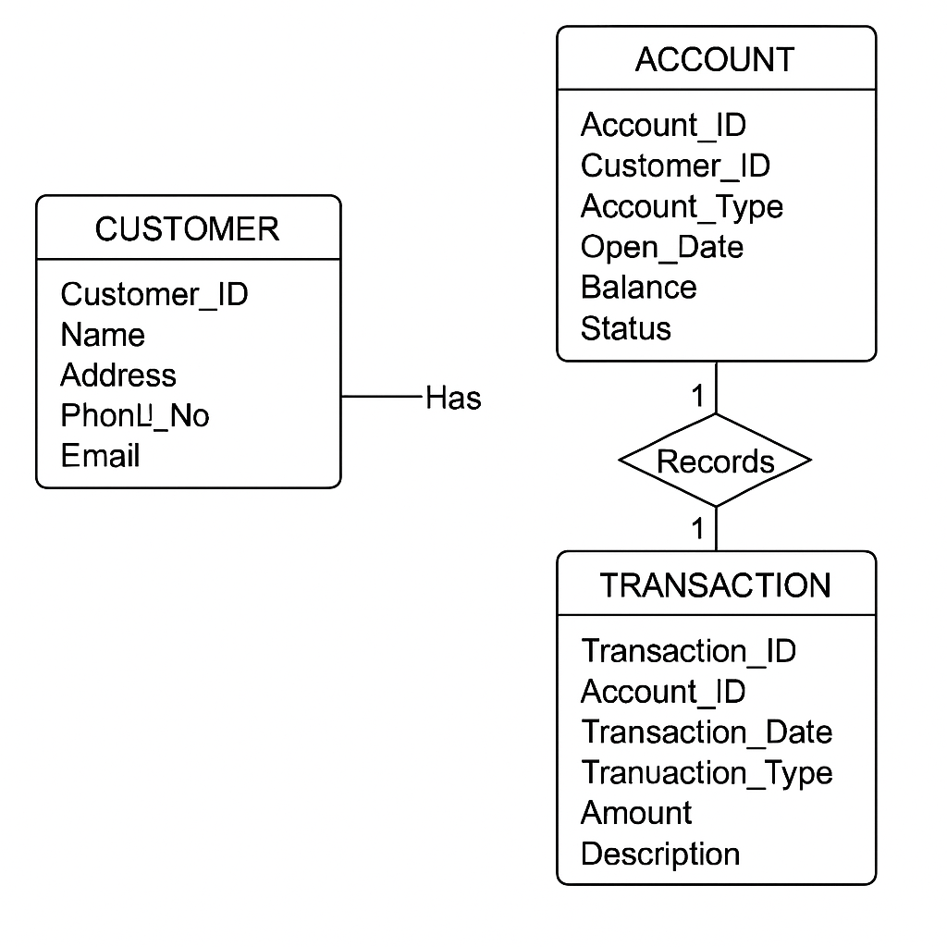
ER diagram of accounts and transactions

Slide 50
Maintainability and Risk Report using CAST Application Intelligence Platform (AIP)
Objective of Reporting Phase
The Reporting phase translates static analysis and architectural data into quantitative software quality metrics. CAST AIP automates this process by analyzing COBOL source code, copybooks, JCLs, DB2 schemas, and other system artifacts to measure maintainability, complexity, and risk exposure.
Tools Used
Tool: CAST AIP (Application Intelligence Platform) Purpose: Generate software quality dashboards and risk assessment reports from static analysis data.

Slide 51
Process Overview
Step | Activity | Description
1 | Code Upload and Analysis | COBOL, copybooks, and DB2 schema files are scanned. CAST builds a meta-model of the system.
2 | Quality Rule Execution | CAST runs 600+ built-in rules detecting violations such as dead code, complex procedures, missing error handling, and data coupling.
3 | Metric Calculation | Metrics like Cyclomatic Complexity, Comment Density, Fan-In/Fan-Out, and Change Propagation are calculated.
4 | Quality Indicators | CAST computes ISO/IEC 5055 indices — Maintainability, Efficiency, Reliability, and Security.
5 | Risk Modeling | CAST AIP identifies risk patterns such as data anomalies, duplicate logic, and tightly coupled modules.
6 | Report Generation | CAST dashboards and PDF/Excel reports summarize findings.

Slide 52
Key Maintainability Metrics
Metric | Description | Example (Legacy COBOL)
Cyclomatic Complexity | Measures logical complexity | COBOL procedure “Calculate_Interest” = 35 (High)
Comment Density | Ratio of comments to code lines | 5% (Low maintainability)
Duplication | % of cloned code blocks | 14% (Detected in multiple transaction programs)
Modular Coupling | Measures inter-module dependency | High coupling between ACCT_UPD and TRAN_PROC
Technical Debt | Effort (in days) to fix violations | 62 days estimated effort

Slide 53
Risk Report Summary (Generated by CAST AIP)
Risk Type | Description | Detected Issues | Severity | Recommendation
Complexity Risk | Overly complex COBOL modules | 25 modules exceed threshold | High | Refactor or split programs
Change Impact Risk | High coupling affects maintainability | 14 dependencies on shared data | High | Modularize and isolate data
Data Integrity Risk | Inconsistent data manipulation | 7 files show redundant logic | Medium | Centralize file handling routines
Duplicate Logic | Repeated business rules in multiple programs | Found in 5 interest calculation modules | Medium | Consolidate into reusable module
Error Handling Risk | Missing exception paths | 10 modules without validation checks | High | Add structured error handling
Documentation Gap | Low comment ratio | Overall < 10% | Medium | Enforce documentation policy

Slide 54
CAST AIP Dashboard Insights
CAST AIP generates an interactive Dashboard for stakeholders:
1. Quality Indicators (ISO/IEC 5055):
Characteristic | Score (0–4) | Status
Maintainability | 2.3 | ⚠️ Needs improvement
Reliability | 3.1 | ✅ Acceptable
Efficiency | 2.8 | ⚠️ Moderate
Security | 3.5 | ✅ Good
Notes:
CAST AIP stands for CAST Application Intelligence Platform. It is a software solution used to analyze applications for code quality, security vulnerabilities, and technical debt, providing insights for management and development teams.

Slide 55
2. Hotspot Visualization (CAST Imaging)
CAST Imaging visually maps:
High-risk COBOL programs
Complex transaction flows
Modules with highest technical debt
You’d see clusters showing “Account Processing” and “Interest Computation” as red zones — indicating complex and interdependent modules needing refactoring.

Slide 56
Conclusion & Recommendation
Refactor High-Complexity Modules: Reduce cyclomatic complexity by modularizing large COBOL programs.
Remove Duplicate Logic: Consolidate repeated business logic into centralized APIs.
Improve Documentation: Increase comment density and enforce code documentation standards.
Plan Gradual Migration: Prioritize modernization of modules flagged as high-risk.

Slide 57
System Analysis - Example
Analyzing HR system for performance bottlenecks
Identifying unused modules

Slide 58
System Analysis - Outcomes
Clear understanding of system scope
Foundation for reverse engineering

Slide 59
Re-Engineering process flow 2. Reverse Engineering

Slide 60
Reverse Engineering - Role
Recover design and specification from code
Helps generate documentation

Slide 61
Importance of Reverse Engineering
Essential for understanding legacy systems
Facilitates system re-engineering
Helps in documentation and knowledge recovery

Slide 62
Definition
Reverse Engineering is the process of analyzing an existing system — software, hardware, or process — to understand its structure, components, and functionality, often with the goal of rebuilding, improving, or integrating it into newer systems.
Reverse Engineering means going backward from product to design — understanding how it was made, rather than making it from scratch.

Slide 63
Formal Definition (Software Context)
Reverse Engineering is the process of examining a system’s source code, architecture, and behavior to extract higher-level representations such as design models, data structures, and requirements that were not available or documented before.

Slide 64
Definition (Industry View)
Used to recover lost knowledge of legacy systems
Common in modernization and security analysis

Slide 65
Purpose of Reverse Engineering
Understanding Legacy Systems: When documentation is missing or outdated, reverse engineering helps recover knowledge about system design, logic, and data flow.
Maintenance and Re-Engineering: It provides insight required to migrate, modernize, or integrate legacy software (like COBOL-based banking systems) into modern architectures.
Error Detection and Debugging: Helps identify bugs, inefficiencies, or vulnerabilities in old or third-party software.
Interoperability and Integration: Used to make new systems compatible with existing (or obsolete) ones.
Security Analysis: Commonly used in cybersecurity to detect malware behavior or to test system vulnerabilities.
Notes:
Vulnerabilities=weaknesses

Slide 66
Why Reverse Engineering Matters
Legacy systems often lack documentation
Critical for safe system migration
Supports compliance and auditing

Slide 67
Phases of Reverse Engineering (Software Systems)
Phase | Description | Example Tools/Techniques
1. Information Extraction | Collecting source code, database schemas, and configuration files. | Source analyzers, decompilers
2. Static Analysis | Analyzing code structure without executing it. | SonarQube, Understand, CAST AIP
3. Dynamic Analysis | Observing runtime behavior (execution flow, memory, data access). | Debuggers, profilers
4. Data/Control Flow Analysis | Mapping how data moves and how modules interact. | ER/Studio, DFD tools
5. Design Recovery | Reconstructing high-level models (UML, architecture diagrams). | Rational Rose, Enterprise Architect
6. Documentation and Reporting | Producing maintainable documentation for re-engineering. | CAST Report Generator, DocTools

Slide 68
Phase 1: Information Extraction (Data Collection)
Purpose
To gather all available artifacts related to the existing system — source code, executables, database schemas, configuration files, documentation (if any), and user manuals.
Techniques
Code extraction – collecting source files from repositories.
Version history mining – retrieving past changes from tools like Git.
Artifact correlation – linking code modules with database tables or user interfaces.
Tools
File explorers, Git, SVN, or CVS
Code repositories (GitHub, Bitbucket)
Dependency scanners like Dependency Walker or Understand
Notes:
Git is a free and open-source distributed version control system (DVCS) designed to handle projects of all sizes with speed and efficiency. Its primary purpose is to track changes in files and coordinate work among multiple people collaborating on the same project.
SVN, or Apache Subversion, is a centralized version control system used for tracking changes in files and directories over time, especially in software development.
CVS, or Concurrent Versions System, is a centralized version control system used to track changes in files and allow multiple developers to collaborate on a project simultaneously.

Slide 69
Example
In a legacy banking system (COBOL):
Extract source programs (.cblfiles), copybooks, job control language (JCL) scripts, and transaction files for analysis.
Output
A comprehensive collection of system artifacts, forming the input for deeper analysis.

Slide 70
Phase 2: Static Analysis
Purpose
To analyze the system without executing it, focusing on code structure, control flow, dependencies, and potential issues.
Techniques
Lexical and syntactic analysis – parsing the source code to identify modules, variables, and functions.
Control Flow Analysis (CFA) – understanding logic paths (if-else, loops).
Dependency analysis – identifying inter-module dependencies.
Code quality analysis – detecting code smells, duplication, or complexity.

Slide 71
Tools
SonarQube – detects duplicated logic, complexity, and maintainability issues.
CAST AIP – performs deep static analysis and risk assessment.
Understand (SciTools) – extracts architecture and dependency graphs.
IDEs (Eclipse, IntelliJ, Visual Studio) – provide structure and class explorers.

Slide 72
Example
Using SonarQube on a COBOL banking application can identify:
Duplicate account validation routines
Hard-coded constants
Unused variables or dead code
Output
Static code metrics, dependency graphs, and code quality reports.

Slide 73
Phase 3: Dynamic Analysis
Purpose
To study the runtime behavior of the system — how it executes, interacts with inputs/outputs, and manages data flow during operation.
Techniques
Execution tracing – recording the flow of function calls during execution.
Profiling – measuring resource usage (CPU, memory, I/O).
Logging and monitoring – capturing system events during operation.
Behavioral modeling – analyzing how inputs are transformed into outputs.

Slide 74
Tools
Debuggers (GDB, WinDbg, COBOL Debugger)
Profilers (JProfiler, Perf, VisualVM)
Dynamic analyzers (Pin, Valgrind)
Monitoring tools (Splunk, AppDynamics)

Slide 75
Example
Running the legacy banking application with test data and tracing:
Transaction processing flow
Account update sequences
Performance bottlenecks during peak loads
Output
Runtime behavior reports, function call sequences, and performance analysis charts.

Slide 76
Phase 4: Data and Control Flow Analysis
Purpose
To understand how data moves through the system and how control is transferred between modules and components.
Techniques
Data Flow Diagrams (DFDs) – visualize data movement between processes.
Entity-Relationship (ER) Diagrams – model database structure.
Control Flow Graphs (CFGs) – represent decision and loop paths.
State Transition Diagrams (STDs) – capture system state changes.

Slide 77
Tools
ER/Studio or Oracle Data Modeler – for ER diagrams.
IBM Rational Rose or Enterprise Architect – for UML modeling.
Code2Flow, Flowgorithm, or PlantUML – for control flow visualization.
CAST AIP – auto-generates dataflow diagrams from code.

Slide 78
Example
In the banking system:
DFDs show data movement from customer input → transaction module → database → audit logs
ER diagrams represent entities like Accounts, Transactions, Customers
Output
A clear set of diagrams illustrating system logic, process flow, and data relationships.

Slide 79
Phase 5: Design Recovery
Purpose
To reconstruct higher-level design and architecture from the analyzed information — essentially moving from code to design.
Techniques
Architecture recovery – identifying system layers, patterns, and frameworks.
UML model generation – class, sequence, component, and deployment diagrams.
Pattern recognition – detecting recurring design patterns.
Abstraction synthesis – deriving conceptual and architectural views.

Slide 80
Tools
Enterprise Architect, Rational Rose, or Visual Paradigm – for UML modeling.
Modelio, Archi, or StarUML – for architecture modeling.
CAST AIP, MoDisco, or ReEngineer – for automated model extraction.
Example
From a COBOL legacy system:
Recreate a 3-tier architecture (presentation, business, database layers)
Generate UML class and sequence diagrams to represent transaction workflows
Output
A full architectural and design-level understanding of the system — suitable for modernization or re-engineering.

Slide 81
Phase 6: Documentation and Reporting
Purpose
To compile all discovered knowledge into structured documentation that aids maintenance, migration, or future development.
Techniques
Automated documentation generation
Knowledge graph construction
Reporting on maintainability and risk
Traceability matrix creation (requirements → modules)

Slide 82
Tools
CAST Report Generator, DocTools, Doxygen, or Sphinx
Microsoft Word, Confluence, or LaTeX for manual documentation
Visualization dashboards (Power BI, Grafana) for metrics reporting
Example
Produce a Maintainability and Risk Report using CAST AIP summarizing:
Code complexity
Security vulnerabilities
Re-engineering recommendations

Slide 83
Output
Complete technical documentation, including:
Architecture diagrams
DFDs and ER diagrams
Code quality and risk metrics
Recommendations for modernization

Slide 84
Example Summary (Banking System Re-engineering)
Input: COBOL-based legacy system Process:
Extract source and data.
Perform static analysis in SonarQube.
Trace runtime behavior using COBOL debugger.
Map transactions and accounts in ER/Studio.
Generate UML architecture in Rational Rose.
Produce maintainability report using CAST AIP.
Output: A complete, documented understanding ready for modernization into Java or microservices.

Slide 85
Reverse Engineering in Software Re-Engineering
Reverse Engineering is the first phase in the Software Re-Engineering process.
Flow:
Reverse Engineering → Analysis → Forward Engineering (Reconstruction)
It helps extract:
Design Models (UML diagrams)
Entity-Relationship (ER) diagrams
Process models
Business rules
Data flow representations
This knowledge is then used in Forward Engineering to:
Rebuild the system using modern technologies
Improve maintainability, performance, and scalability

Slide 86
Types of Reverse Engineering
Reverse engineering can be categorized based on purpose, level of abstraction, or focus area. Here are the major types:
1. Program (Code-Level) Reverse Engineering
Focus: Source code or binary analysis. Goal: Understand the internal logic, algorithms, data structures, and dependencies.
Used in:
Legacy COBOL or C system analysis.
Identifying code smells, duplicated logic, and unused modules.
Techniques/Tools:
Static analysis (e.g., SonarQube, Understand)
Dynamic analysis (profilers, debuggers)
Decompilation (if source code missing)
Example: Analyzing COBOL banking modules to extract transaction rules and file access logic.
Notes:
Decompilation is the process of translating an executable (machine code or bytecode) back into a higher-level programming language that is human-readableIt’s essentially the reverse of compilation.

Slide 87
2. Data Reverse Engineering
Focus: Database, data files (like VSAM), or data models.
Goal: Discover the logical and physical structure of data, relationships, and constraints.
Used in:
Migration from mainframe files to relational databases (e.g., DB2 → Oracle).
Rebuilding missing ER diagrams.
Techniques/Tools:
ER/Studio, Oracle Data Modeler, SQL Reverse Engineering tools.
Example: Reverse-engineering VSAM or DB2 schemas to create an ER diagram of accounts, transactions, and customers.
Notes:
VSAM (Virtual Storage Access Method) is a high-performance file storage system developed by IBM for its mainframe operating systems (z/OS, MVS, VSE). It is not a database, but a file access method that organizes and retrieves data efficiently.

Slide 88
3. Architecture Reverse Engineering
Focus: Software architecture — components, modules, and dependencies.
Goal: Identify the overall system structure, control flow, and inter-module relationships.
Used in:
Large monolithic legacy systems.
Planning for modularization or microservices migration.
Techniques/Tools:
CAST AIP, Structure101, Lattix, Visual Paradigm.
Example: Extracting a component diagram of a banking system showing modules

Slide 89
4. Design Reverse Engineering
Focus: Software design (UML diagrams, data flow, control structures).
Goal: Reconstruct design documentation (UML, DFDs, class diagrams) from code.
Used in:
When design documents are lost or outdated.
For maintenance and modernization planning.
Techniques/Tools:
Rational Rose, Enterprise Architect, Visual Paradigm, Code2Flow.
Example: Generating a DFD (Data Flow Diagram) for “Deposit Transaction” from COBOL code.

Slide 90
5. Interface Reverse Engineering
Focus: System interfaces — APIs, file formats, communication protocols.
Goal: Understand how different systems or components interact.
Used in:
Integration or replacement of legacy subsystems.
Creating wrappers or adapters.
Techniques/Tools:
Wireshark (network), API sniffers, Swagger/OpenAPI generation tools.
Example: Revealing how COBOL batch jobs send transaction data to external settlement systems.

Slide 91
6. Security Reverse Engineering
Focus: Security mechanisms, encryption, and vulnerabilities.
Goal: Identify weaknesses, malicious code, or recover lost algorithms.
Used in:
Security audits or malware analysis (ethical contexts).
Verifying compliance and access control logic.
Techniques/Tools:
Disassemblers (IDA Pro), debuggers, penetration testing tools.
Example: Analyzing COBOL code that encrypts customer PINs or stores credentials.

Slide 92
7. Network/Protocol Reverse Engineering
Focus: Communication protocols and message structures.
Goal: Decode undocumented network interactions or legacy message formats.
Used in:
Integrating legacy mainframes with modern web or mobile systems.
Migrating to REST or SOAP-based APIs.
Techniques/Tools:
Wireshark, Fiddler, tcpdump.
Example: Understanding how a COBOL-based batch job communicates with ATM host systems.
Notes:
REST=Representational State Transfer is an architectural style for building lightweight, fast, and scalable web services using standard HTTP methods.
SOAP=Simple Object Access Protocol is a protocol-based web service communication standard that uses XML to structure messages.

Slide 93
8. Model Reverse Engineering
Focus: Reconstructing high-level models (UML, BPMN, flowcharts).
Goal: Visualize logic for understanding, maintenance, or training.
Used in:
Documentation and modernization projects.
Generating visual process models.
Techniques/Tools:
Enterprise Architect, Visual Paradigm, StarUML.
Example:
Deriving a UML Activity Diagram from COBOL code showing transaction processing flow.
Notes:
BPMN (Business Process Model and Notation) is a graphical standard for modeling business processes.

Slide 94
Benefits of Reverse Engineering
Knowledge recovery
Improved system maintainability
Supports modernization projects

Slide 95
Challenges of Reverse Engineering
Time-consuming
May not recover full intent
Requires expertise and tools

